Slide 1

SENIOR PROJECT 2
Lecturer: Ph.D Phạm Văn Khoa
Đỗ Mạnh Dũng - 21119301
Trần Long - 21119311
Đặng Trung Nghĩa - 21119313

Slide 2

Design and implementation an RISC-V core 32-bit with C and M extensions

Slide 3

Base-I | RV32I ISA
R-Type
add(w), sub(w), xor, or, and, sll(w), srl(w), sra(w), slt, sltu
I-Type
addi(w), xori, ori, andi, slli(w), srli(w), srai(w), slti, sltiu
lb(u), lh(u), lw(u), ld
jalr
S-Type
sb, sh, sw, sd
B-Type
beq, bne, blt(u), bge(u)
J-Type
jal
U-Type
lui, auipc

Slide 4
Base-I | RV32I Microarchitecture
Subset of Base-I from Harris & Harris Book

Slide 5
Base-I | RV32I Microarchitecture
Design Methodology:
Start by designing Single Cycle Datapath
Add Control Unit
Pipeline the Single Cycle
Add Hazard Unit

Slide 6
Base-I | RV32I Microarchitecture
Design Methodology:
Start by designing Single Cycle Datapath
Datapath: start with lw instruction
Example: lw rd, imm(rs1)
I-Type
31:20 | 19:15 | 14:12 | 11:7 | 6:0
imm | rs1 | funct3 | rd | Op
12 bits | 5 bits | 3 bits | 5 bits | 7 bits

Slide 7
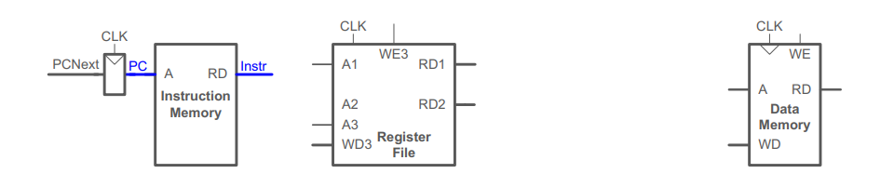
Base-I | RV32I Microarchitecture
Design Methodology:
Start by designing Single Cycle Datapath
Datapath: start with lw instruction
Example: lw rd, imm(rs1)
lw fetch

Slide 8
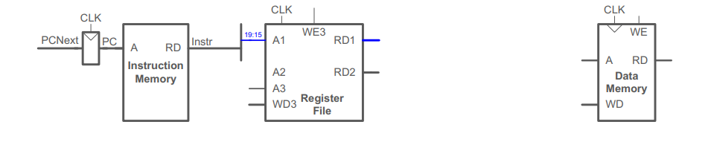
Base-I | RV32I Microarchitecture
Design Methodology:
Start by designing Single Cycle Datapath
Datapath: start with lw instruction
Example: lw rd, imm(rs1)
lw Reg Read

Slide 9
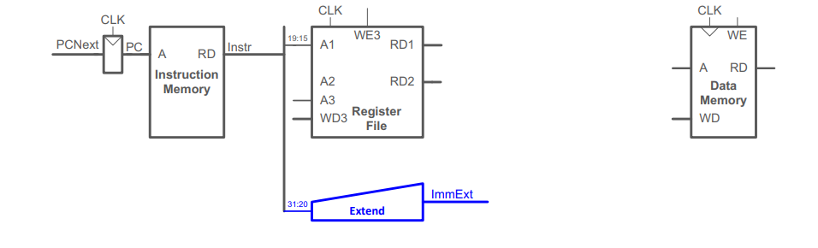
Base-I | RV32I Microarchitecture
Design Methodology:
Start by designing Single Cycle Datapath
Datapath: start with lw instruction
Example: lw rd, imm(rs1)
lw Immediate

Slide 10
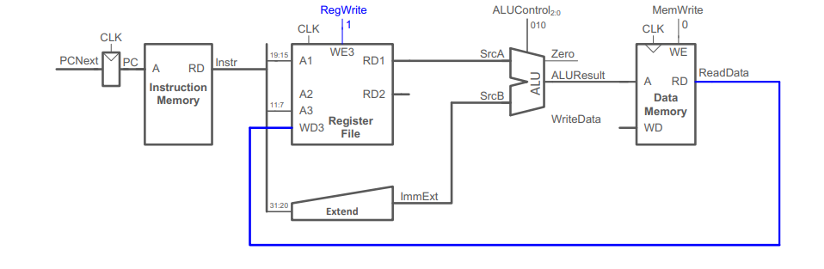
Base-I | RV32I Microarchitecture
Design Methodology:
Start by designing Single Cycle Datapath
Datapath: start with lw instruction
Example: lw rd, imm(rs1)
lw Mem Read

Slide 11
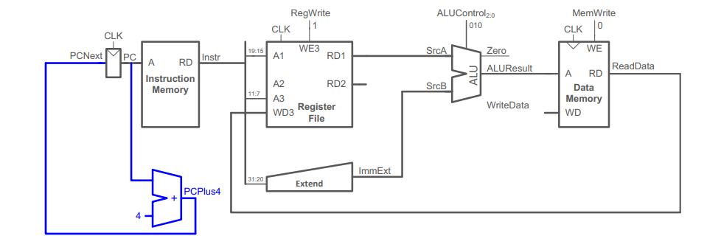
Base-I | RV32I Microarchitecture
Design Methodology:
Start by designing Single Cycle Datapath
Datapath: start with lw instruction
Example: lw rd, imm(rs1)
PC Increment

Slide 12
Base-I | RV32I Microarchitecture
Design Methodology:
Start by designing Single Cycle Datapath

Slide 13
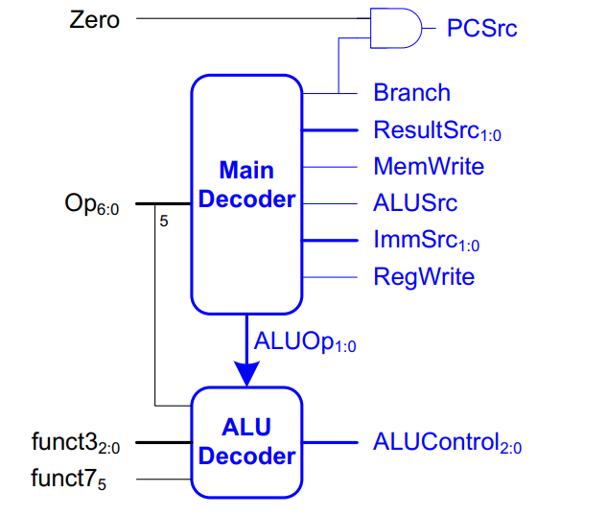
Base-I | RV32I Microarchitecture
Design Methodology:
Add Control Unit

Slide 14
Base-I | RV32I Microarchitecture
Design Methodology:
Add Control Unit

Slide 15
Base-I | RV32I Microarchitecture
Design Methodology:
Pipeline the Single Cycle
Add pipelines.

Slide 16
Base-I | RV32I Microarchitecture
Design Methodology:
Pipeline the Single Cycle
Correct Pipelined Datapath. (Rd must arrive at same time as Result)

Slide 17
Base-I | RV32I Microarchitecture
Design Methodology:
Pipeline the Single Cycle
Add Control Unit. (control signals travel with their instructions)

Slide 18
Base-I | RV32I Microarchitecture
Design Methodology:
Add Hazard Unit

Slide 19
Base-I | RV32I Microarchitecture
Instruction | Format | Opcode | Funct3 | Funct7 | Description
lb | I | 0000011 | 0x0 |  | rd = M[rs1+imm][7:0]
lh | I | 0000011 | 0x1 |  | rd = M[rs1+imm][15:0]
lbu | I | 0000011 | 0x4 |  | rd = M[rs1+imm][7:0]
lhu | I | 0000011 | 0x5 |  | rd = M[rs1+imm][15:0]
sb | S | 0100011 | 0x0 |  | M[rs1+imm][7:0] = rs2[7:0]
sh | S | 0100011 | 0x1 |  | M[rs1+imm][15:0] = rs2[15:0]
bne | B | 1100011 | 0x1 |  | if(rs1 != rs2) PC += imm
blt | B | 1100011 | 0x4 |  | if(rs1 < rs2) PC += imm
bge | B | 1100011 | 0x5 |  | if(rs1 >= rs2) PC += imm
bltu | B | 1100011 | 0x6 |  | if(rs1 < rs2) PC += imm
bgeu | B | 1100011 | 0x7 |  | if(rs1 >= rs2) PC += imm
jalr | I | 1100111 | 0x0 |  | rd = PC+4; PC = rs1 + imm
lui | U | 0110111 |  |  | rd = imm << 12
auipc | U | 0010111 |  |  | rd = PC + (imm << 12)
Subset of Base-I from Harris & Harris Book

Slide 20
Base-I | RV32I Microarchitecture
Instruction | Format | Opcode | Funct3 | Funct7 | Description
lb | I | 0000011 | 0x0 |  | rd = M[rs1+imm][7:0]
lh | I | 0000011 | 0x1 |  | rd = M[rs1+imm][15:0]
lbu | I | 0000011 | 0x4 |  | rd = M[rs1+imm][7:0]
lhu | I | 0000011 | 0x5 |  | rd = M[rs1+imm][15:0]
sb | S | 0100011 | 0x0 |  | M[rs1+imm][7:0] = rs2[7:0]
sh | S | 0100011 | 0x1 |  | M[rs1+imm][15:0] = rs2[15:0]
bne | B | 1100011 | 0x1 |  | if(rs1 != rs2) PC += imm
blt | B | 1100011 | 0x4 |  | if(rs1 < rs2) PC += imm
bge | B | 1100011 | 0x5 |  | if(rs1 >= rs2) PC += imm
bltu | B | 1100011 | 0x6 |  | if(rs1 < rs2) PC += imm
bgeu | B | 1100011 | 0x7 |  | if(rs1 >= rs2) PC += imm
jalr | I | 1100111 | 0x0 |  | rd = PC+4; PC = rs1 + imm
lui | U | 0110111 |  |  | rd = imm << 12
auipc | U | 0010111 |  |  | rd = PC + (imm << 12)

Slide 21
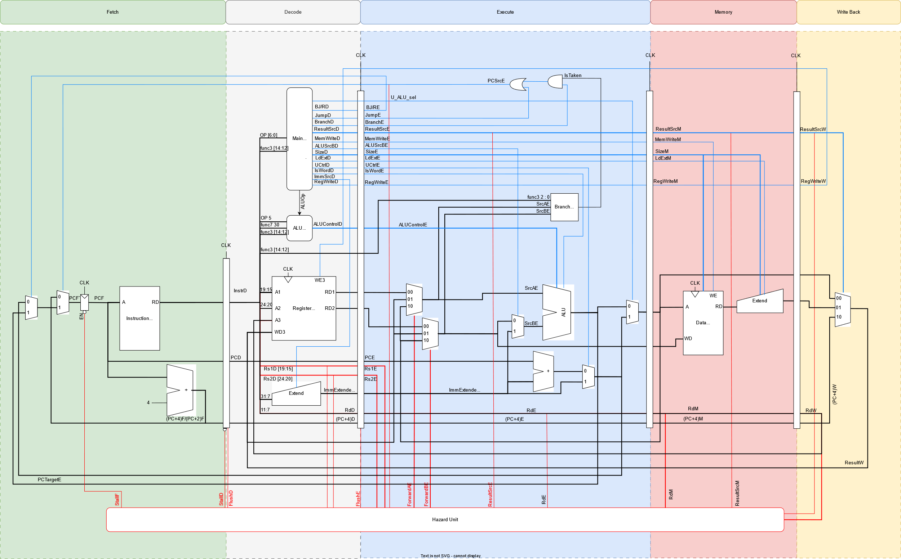
Base-I | RV32I Microarchitecture
lb(u), lh(u), sb, sh
Handled in Data memory & Load extend

Slide 22
Base-I | RV32I Microarchitecture
B-Type
Handled in Branch unit

Slide 23
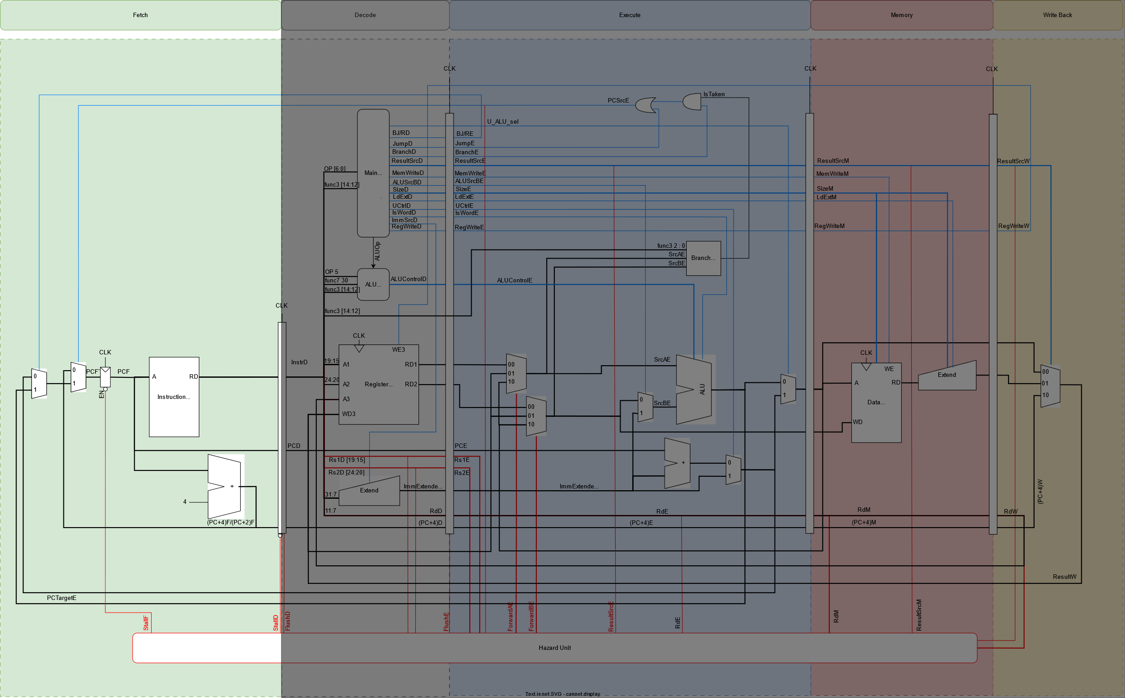
Base-I | RV32I Design: Fetch Stage

Slide 24
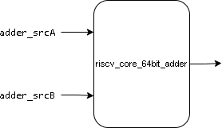
Base-I | RV32I Design: Fetch Stage
32-bit adder
It is used to increment PC
I/O | Width | Description
i_32bit_adder_srcA | 32 | Operand 1 (current PC)
i_32bit_adder_srcB | 32 | Operand 2 (32’h4)
o_32bit_adder_result | 32 | Adder result (32+4)

Slide 25
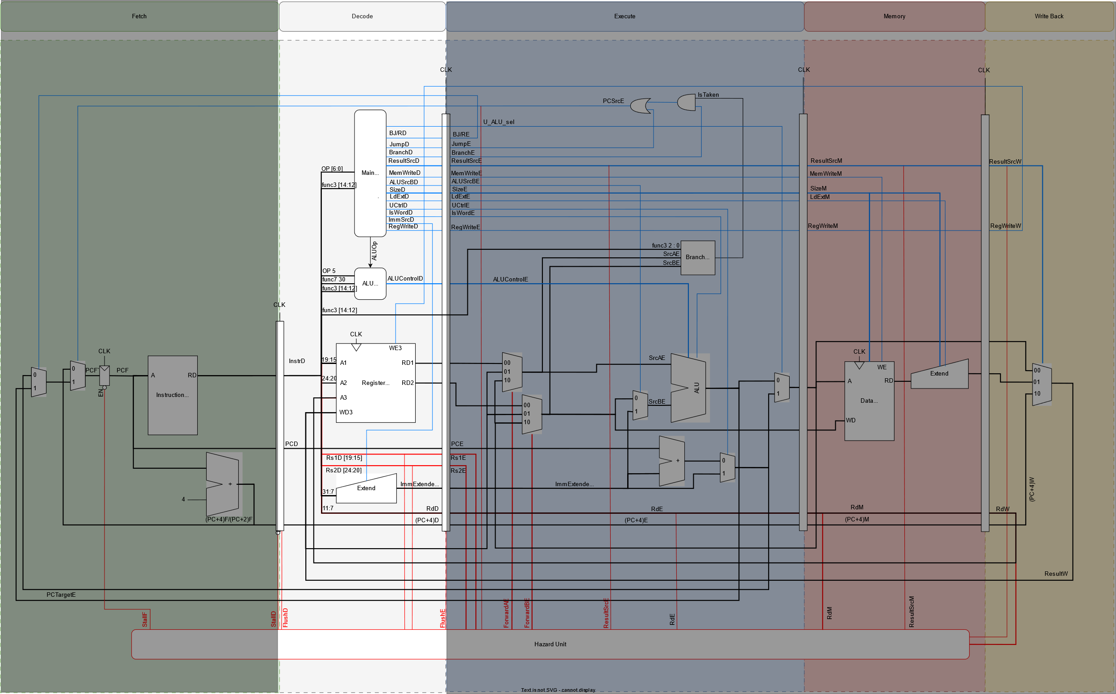
Base-I | RV32I Design: Decode Stage

Slide 26
Base-I | RV32I Design: Decode Stage
Main Decoder
o_imsrc
o_UCtrl
o_resultsrc
i_opcode
o_regwrite
o_alusrcB
o_memwrite
o_branch
i_funct3
riscv_core_main_decoder
o_jump
o_bjreg
o_size
o_LdExt
i_funct7
o_isword
o_aluop
o_imsel
o_new_mux_sel
o_read

Slide 27
Base-I | RV32I Design: Decode Stage
ALU Decoder
Port Name | Direction | Width | Description
i_funct3 | Input | 3 | funct3 bits of the instruction
i_aluop | Input | 1 | Enables the ALU decoder
i_funct7_5 | Input | 1 | Bit number 5 of funct7 part of the instruction
i_funct7_0 | Input | 1 | Bit number 0 of funct7 part of the instruction
i_opcode_5 | Input | 1 | Bit number 5 of opcode part of the instruction
o_alu_control | Output | 4 | Specifies the ALU operation
i_funct3
i_aluop
i_funct7_5
riscv_core_alu_decoder
o_alu_control
i_funct7_0
i_opcode_5

Slide 28
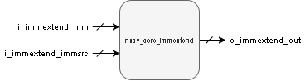
Base-I | RV32I Design: Decode Stage
Immediate Extend
I/O | Width | Description
i_immextend_imm | 25 | Instr[31:20]
 |  | Instr[31:25], Instr[11:7]
 |  | Instr[31:12]
i_immextend_immsrc | 3 | Type of extend according to instruction type
O_immextend_out | 32 | Extended output

Slide 29
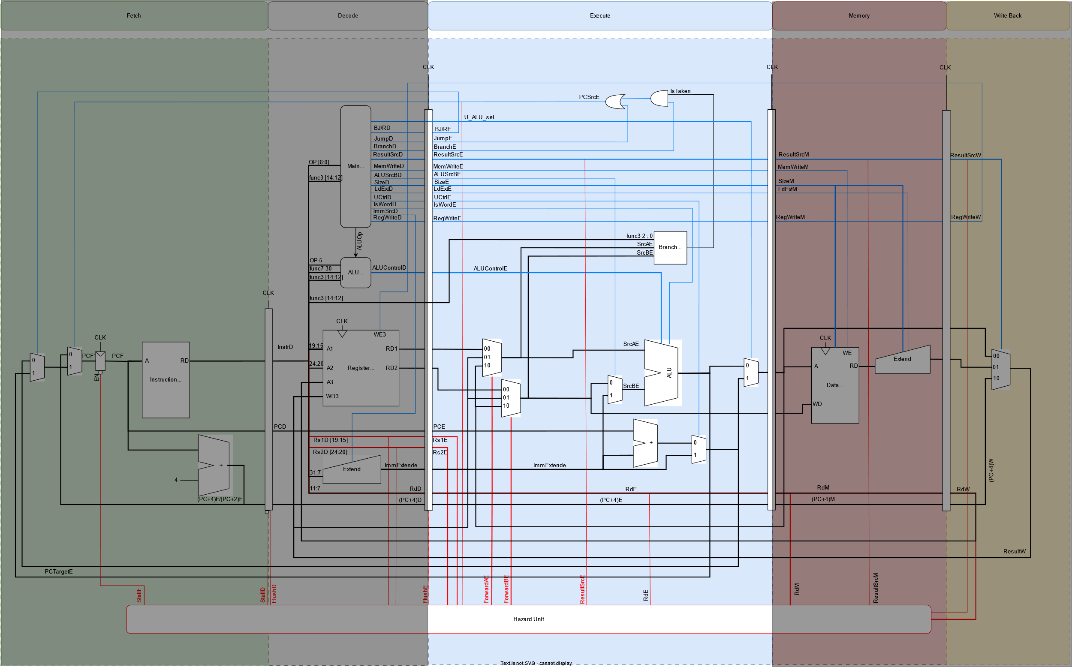
Base-I | RV32I Design: Execute Stage

Slide 30
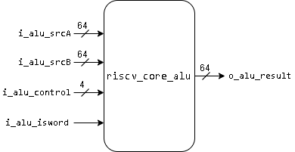
Base-I | RV32I Design: Execute Stage
ALU
I/O | Width | Description
i_alu_srcA | 32 | Operand 1
i_alu_srcB | 32 | Operand 2
i_alu_control | 4 | ALU operation
i_alu_isword | 1 | Specifies whether the instr is word or not
o_alu_result | 32 | ALU result

Slide 31
Base-I | RV32I Design: Execute Stage
i_alu_isword | i_alu_control | Operation
1’b0 | 4’b0000 | o_alu_result = i_alu_srcA + i_alu_srcB
1’b0 | 4’b0001 | o_alu_result = i_alu_srcA - i_alu_srcB
1’b0 | 4’b0110 | o_alu_result = i_alu_srcA ^ i_alu_srcB
1’b0 | 4’b0011 | o_alu_result = i_alu_srcA | i_alu_srcB
1’b0 | 4’b0010 | o_alu_result = i_alu_srcA & i_alu_srcB
1’b0 | 4’b0100 | o_alu_result = i_alu_srcA << i_alu_srcB[5:0]
1’b0 | 4’b0111 | o_alu_result = i_alu_srcA >> i_alu_srcB[5:0]
1’b0 | 4’b1111 | o_alu_result = i_alu_srcA >>> i_alu_srcB[5:0]
1’b0 | 4’b0101 | o_alu_result = i_alu_srcA < i_alu_srcB
1’b0 | 4’b1000 | o_alu_result = i_alu_srcA(U) < i_alu_srcB(U)
1’b1 | 4’b0000 | o_alu_result = i_alu_srcA[31:0] + i_alu_srcB[31:0] (sign ext)
1’b1 | 4’b0001 | o_alu_result = i_alu_srcA[31:0] - i_alu_srcB[31:0] (sign ext)
1’b1 | 4’b0100 | o_alu_result = i_alu_srcA[31:0] << i_alu_srcB[4:0] (sign ext)
1’b1 | 4’b0111 | o_alu_result = i_alu_srcA[31:0] >> i_alu_srcB[4:0] (sign ext)
1’b1 | 4’b1111 | o_alu_result = i_alu_srcA[31:0] >>> i_alu_srcB[4:0] (sign ext)
ALU

Slide 32
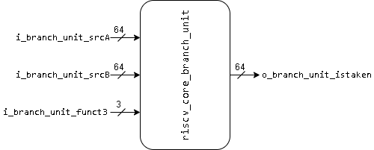
Base-I | RV32I Design: Execute Stage
Branch Unit
I/O | Width | Description
i_branch_unit_srcA | 32 | Operand 1
i_branch_unit_srcB | 32 | Operand 2
i_branch_unit_funct3 | 3 | Specifies branch instr
o_branch_unit_istaken | 1 | Flag raised if the condition is true

Slide 33
Base-I | RV32I Design: Execute Stage
Branch Unit
i_branch_unit_funct3 | Instr. | Operation
3’b000 | BEQ | istaken = i_branch_unit_srcA == i_branch_unit_srcB
3’b001 | BNE | istaken = i_branch_unit_srcA != i_branch_unit_srcB
3’b100 | BLT | istaken = i_branch_unit_srcA < i_branch_unit_srcB
3’b101 | BGE | istaken = i_branch_unit_srcA >= i_branch_unit_srcB
3’b110 | BLTU | istaken = i_branch_unit_srcA(U) < i_branch_unit_srcB(U)
3’b111 | BGEU | Istaken = i_branch_unit_srcA(U) >= i_branch_unit_srcB(U)

Slide 34
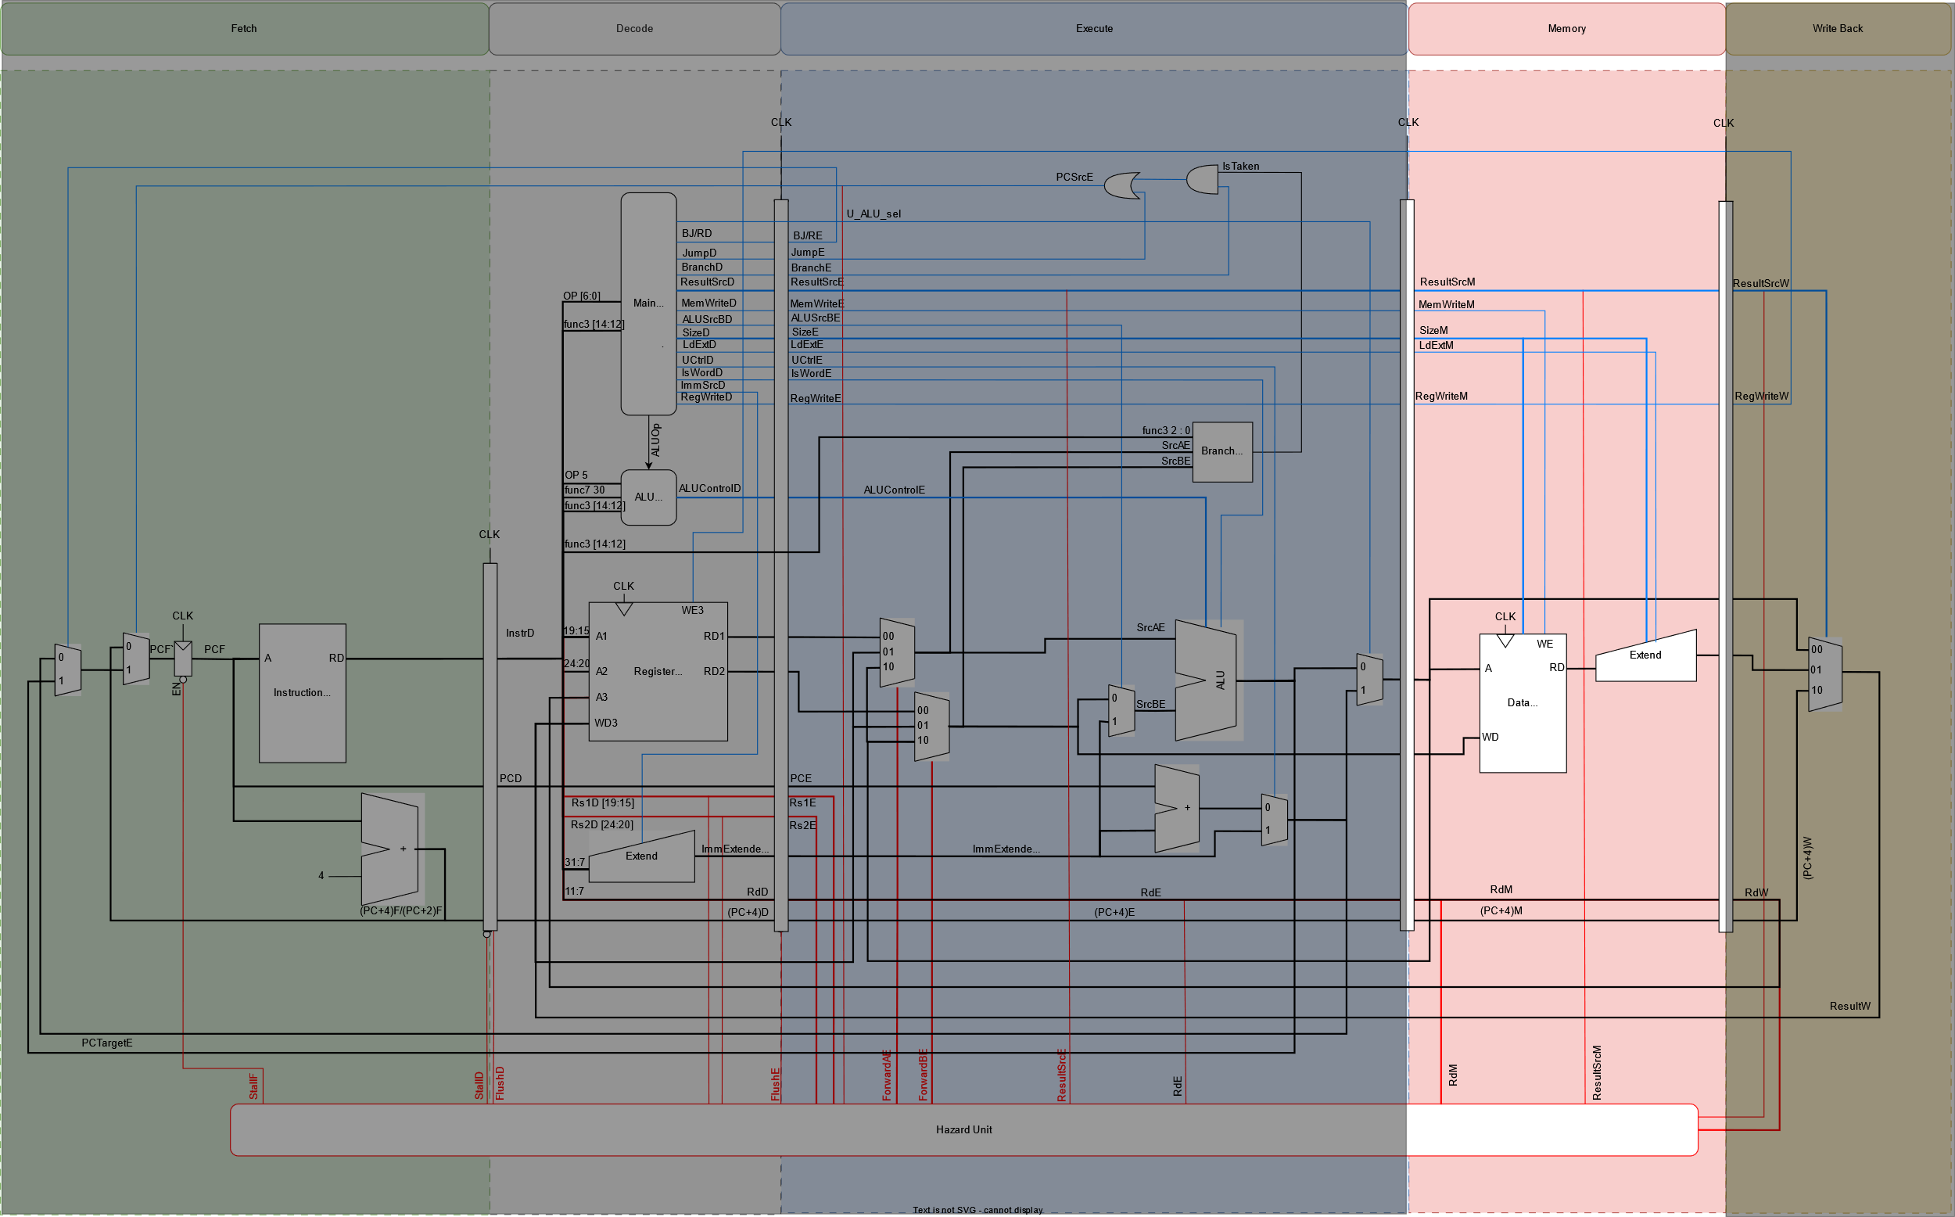
Base-I | RV32I Design: Memory Stage

Slide 35
Base-I | RV32I Design: Memory Stage
Load Extend
Port Name | Direction | Width | Description
i_su_extend | Input | 1 | Determines whether the instruction is signed or unsigned.
i_r_w_size | Input | 2 | Determines the size of the load instruction e.g., LD, LW, LH, LB.
i_rdata | Input | 32 | Data loaded from memory without extend.
o_rdata | Output | 32 | Data loaded from memory after sign/zero extend.
i_su_extend
i_r_w_size
riscv_core_ldextend
o_rdata
i_rdata

Slide 36
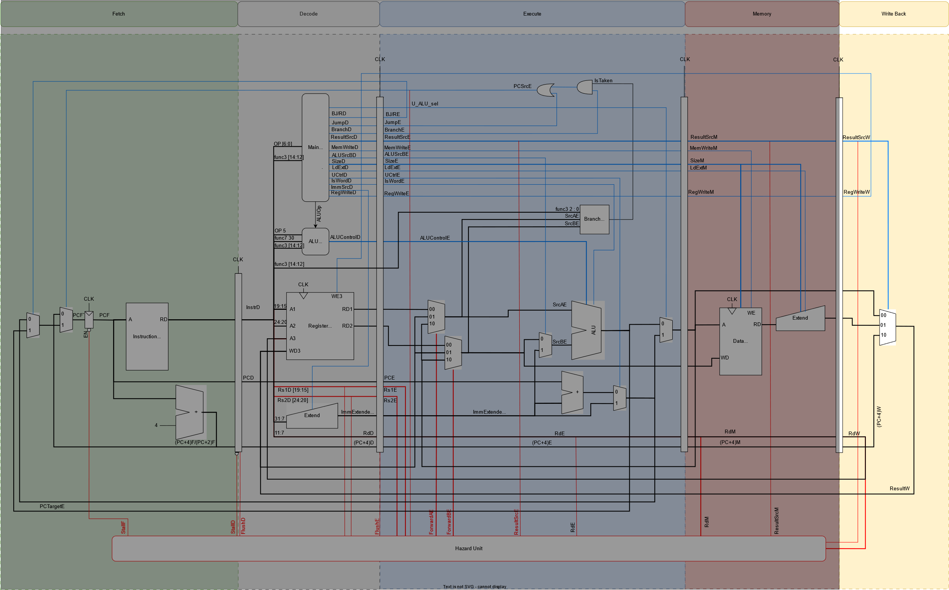
Base-I | RV32I Design: Writeback Stage

Slide 37
Base-I | RV32I Design: Writeback Stage
Writeback Mux
resultsrc | Operation
2’b00 | Writes back the data computed from EX stage
2’b01 | Writes back the data loaded from data memory
2’b10 | Writes back PC+4 for JAL & JALR instructions

Slide 38
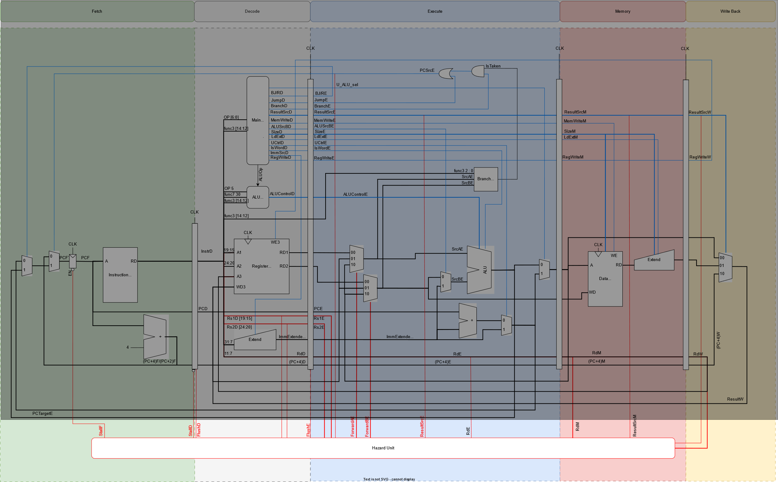
Base-I | RV32I Design: Hazard Unit

Slide 39
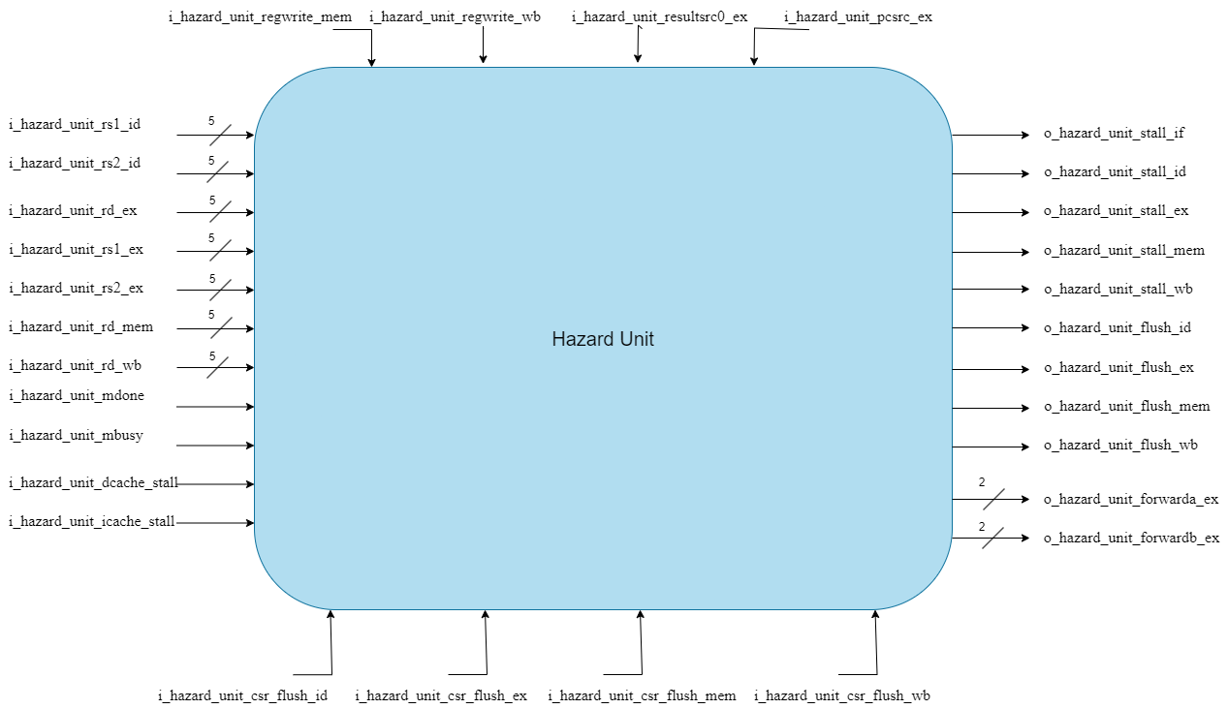
Base-I | RV32I Design: Hazard Unit
HU Block Diagram

Slide 40
Base-I | RV32I Design: Hazard Unit
I/O | Width | Description
i_hazard_unit_rs1_id | 5 | RV32I Hazard Detection Control Signals
i_hazard_unit_rs2_id | 5
i_hazard_unit_rs1_ex | 5
i_hazard_unit_rs2_ex | 5
i_hazard_unit_rd_ex | 5
i_hazard_unit_rd_mem | 5
i_hazard_unit_rd_wb | 5
i_hazard_unit_regwrite_mem | 1
i_hazard_unit_regwrite_wb | 1
i_hazard_unit_resultsrc_ex | 2
i_hazard_unit_pcsrc_ex | 1
I/O | Width | Description
i_hazard_unit_mdone | 1 | RV32M Hazard Detection Signals
i_hazard_unit_mbusy | 1
i_hazard_unit_dcache_stall | 1 | I&D Caches Hazrad Detection Signals
i_hazard_unit_icache_stall | 1
i_hazard_unit_csr_flush_id | 1 | CSR Hazard Detection Signals
i_hazard_unit_csr_flush_ex | 1
i_hazard_unit_csr_flush_mem | 1
i_hazard_unit_csr_flush_wb | 1

Slide 41
Base-I | RV32I Design: Hazard Unit
I/O | Width | Description
o_hazard_unit_forwarda_ex | 2 | Forwarding Control Signals
o_hazard_unit_forwardb_ex | 2
o_hazard_unit_stall_if | 1 | Stall Control Signals
o_hazard_unit_stall_id | 1
o_hazard_unit_stall_ex | 1
o_hazard_unit_stall_mem | 1
o_hazard_unit_stall_wb | 1
o_hazard_unit_flush_id | 1 | Flush Control Signals
o_hazard_unit_flush_ex | 1
o_hazard_unit_flush_mem | 1
o_hazard_unit_flush_wb | 1

Slide 42
Base-I | RV32I Design: Hazard Unit
For RV32I Base:
RAW data hazards occur when an instruction depends on a result that has not yet been written.
RAW can be resolved by forwarding if the result is computed soon enough.
Otherwise, stalling the pipeline until the result is available.

Slide 43
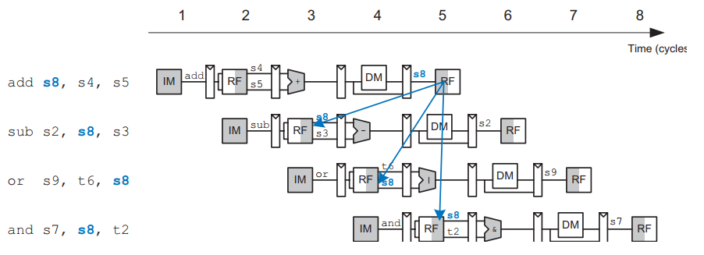
Base-I | RV32I Design: Hazard Unit
RAW Hazard Example:

Slide 44
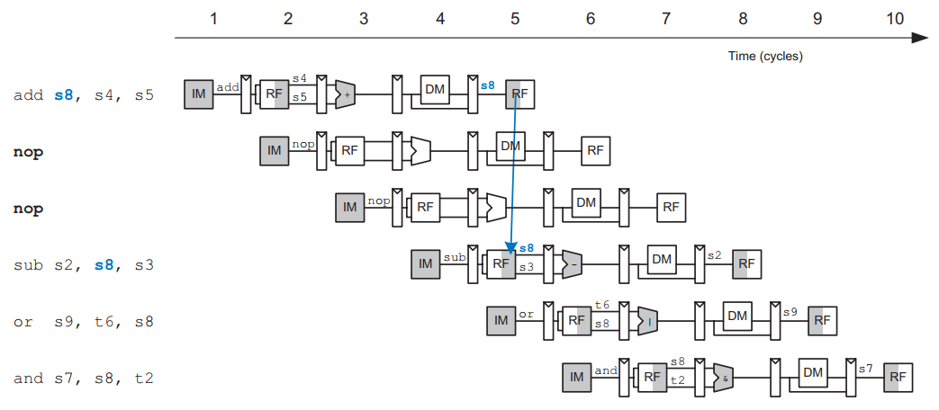
Base-I | RV32I Design: Hazard Unit
SW Solution to RAW Hazard Example:

Slide 45
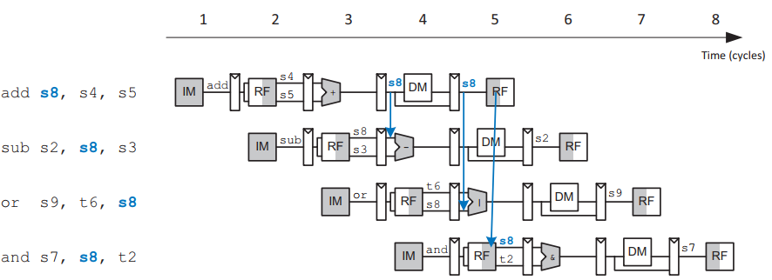
Base-I | RV32I Design: Hazard Unit
HW Solution to RAW Hazard Example: "Forwarding"

Slide 46
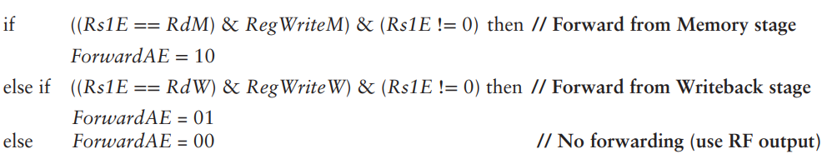
Base-I | RV32I Design: Hazard Unit
Forwarding is necessary when an instruction in the Execute stage has a source register matching the destination register of an instruction in the Memory or Writeback stage.

Slide 47
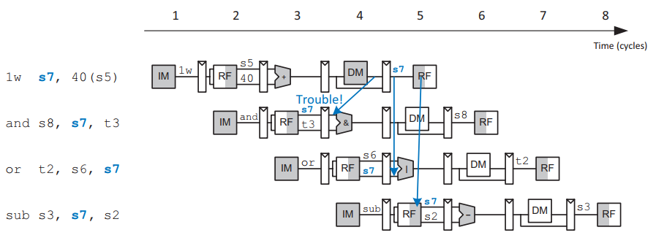
Base-I | RV32I Design: Hazard Unit
Unfortunately, the lw instruction does not finish reading data until the end of the Memory stage, so its result cannot be forwarded to the Execute stage of the next instruction.
We say that the lw instruction has a two-cycle latency.

Slide 48
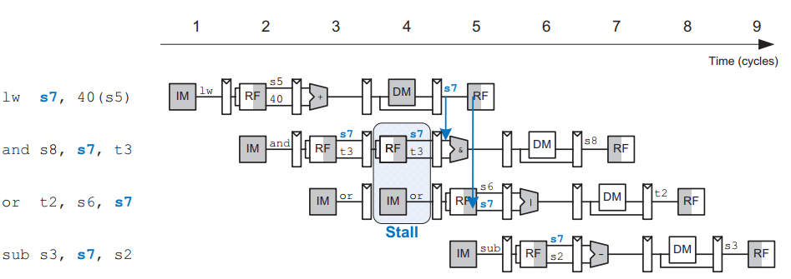
Base-I | RV32I Design: Hazard Unit
Solution to lw hazard: "Stall"

Slide 49
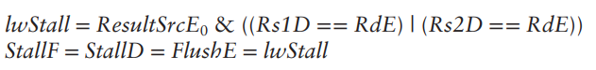
Base-I | RV32I Design: Hazard Unit
Note that the Execute stage is unused in cycle 4.
The bubble is introduced by zeroing out the Execute stage control signals during a Decode stage stall.
so that the bubble performs no action and changes no architectural state.

Slide 50
Base-I | RV32I Design: Hazard Unit
For RV32I Base:
Control hazards occur when the decision of branching has not been made by the time the next instruction must be fetched.
Control hazards can be resolved by stalling the pipeline until the decision is made or by branch prediction.
Moving the decision as early as possible minimizes the number of instructions that are flushed on a misprediction.

Slide 51
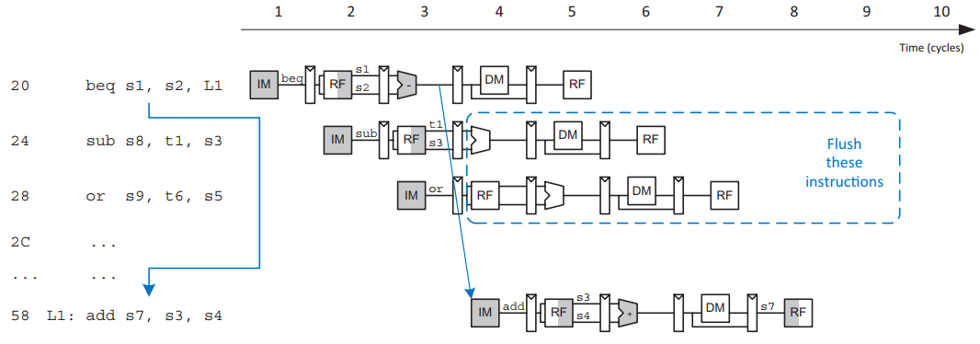
Base-I | RV32I Design: Hazard Unit
The beq instruction presents a control hazard: "Flush"

Slide 52
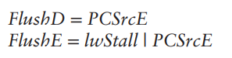
Base-I | RV32I Design: Hazard Unit
The processor predicts that branches are not taken and simply continues executing the program in order until PCSrcE is computed.

Slide 53
Base-I | RV32I Design: Hazard Unit
For RV32M:
Data Hazard occur when an instruction depends on the Multiplication/Division result.
This Data Hazard is resolved by stalling the pipeline depending on two flags from the M-extension:
m_done
m_busy

Slide 54
Base-I | RV32I Design: Hazard Unit
For Caches:
The Cache hazards occur when a cache miss happens.
The Cache hazards can be resolved by stalling the pipeline until fetching new data from the memory.

Slide 55
Implementation of Compressed ISA

Slide 56
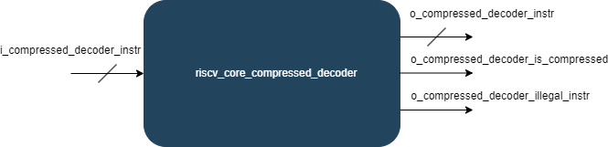
C-Extension : Compressed Decoder
Block Diagram
I/O | Width | Description
i_compressed_decoder_instr | 32 | Input Compressed/Normal Instruction.
o_compressed_decoder_instr | 32 | Output Compressed/Normal Instruction.
o_compressed_decoder_is_compressed | 1 | Output Flag indicates that the input instruction is compressed.
o_compressed_decoder_illegal_instr | 1 | Output Flag indicates that the input instruction is illegal.

Slide 57
C-Extension : Compressed Decoder
This chapter describes the RVC-Extension which reduces the size of common integer instructions to 16 bits.
By reducing the sizes of the control, immediate, and register fields.
The subset was selected to cover the most used instructions in their most used form.
C extension decreases cost, power, and required memory.

Slide 58
C-Extension : Compressed Decoder
According to the RISC-V Instruction Set Manual, typically 50% to 60% of a program’s instructions can be replaced with RVC instructions, resulting in a 25%–30% code-size reduction.
The C extension allows 16-bit instructions to be freely intermixed with 32-bit instructions.
The decoder checks on the two LSBs, "11" is the normal 32-bit instruction encoding.

Slide 59
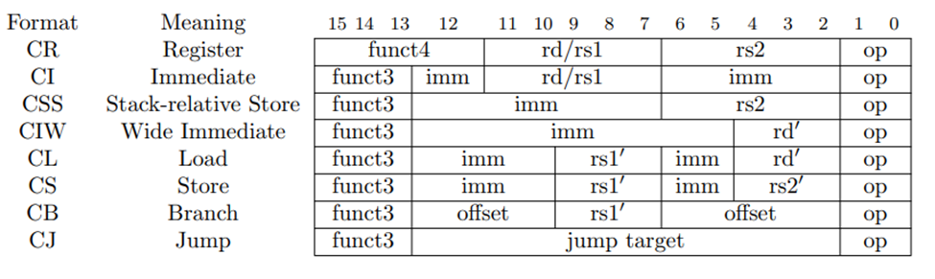
C-Extension : Compressed Decoder
Compressed Instruction Formats:
CR, CI, and CSS can use any of the 32 RVI registers.
CIW, CL, CS, CA, and CB are limited to just 8 of them.

Slide 60
C-Extension : Compressed Decoder
The formats were designed to:
keep bits for the two source registers in the same place in all instructions.
When the full 5-bit destination register specifier is present, it is in the same place as in the 32-bit RISC-V encoding.
Otherwise, the destination register field can move.
Immediate fields have been scrambled, as in the base specification, to reduce the number of immediate muxes required.
RVC Instruction Set is divided to 4-quadrants of the encoding space.
The last quadrant "11" is the normal 32-bit instruction.

Slide 61
C-Extension : Compressed Decoder
Several instructions are only valid for certain operands; when invalid, they are marked either:
RES to indicate that the opcode is reserved for future standard extensions.
NSE to indicate that the opcode is reserved for custom extensions.
HINT to indicate that the opcode is reserved for microarchitectural hints.
HINTs instructions do not modify any architectural state and are executed as no-ops on implementations that ignore them.
Example:
rd=x0 (e.g. C.ADD x0, t0).
rd is overwritten with a copy of itself (e.g. C.ADDI t0, 0).

Slide 62
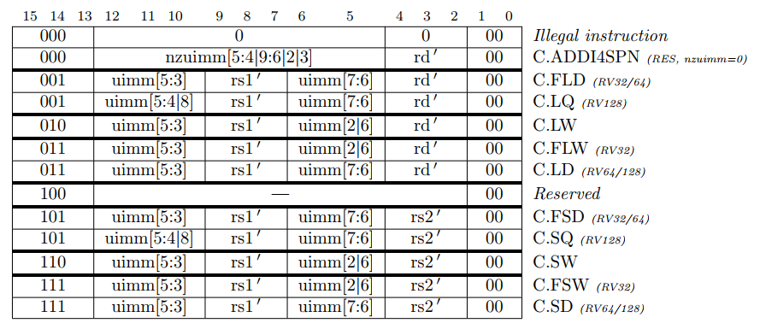
C-Extension : Compressed Decoder
RVC Instruction Set Listings for Quadrant-0

Slide 63
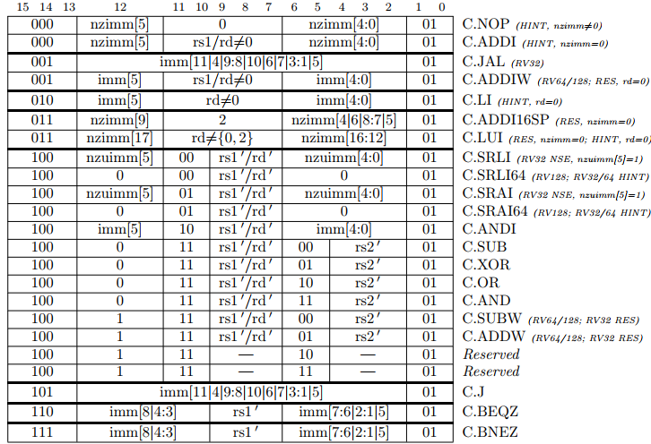
C-Extension : Compressed Decoder
RVC Instruction Set Listings for Quadrant-1

Slide 64
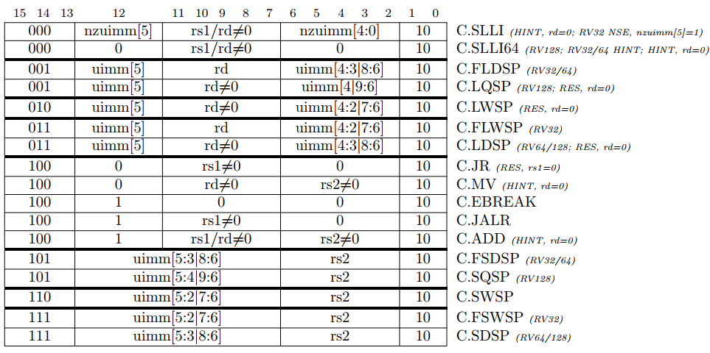
C-Extension : Compressed Decoder
RVC Instruction Set Listings for Quadrant-2

Slide 65
Implementation of M ISA

Slide 66
Integer Multiplication And Division Instructions Extension
RV32M ISA introduces a total of thirteen multiplication and division instructions as shown in the table.
Instruction | Format | Opcode | Funct3 | Funct7 | Description
mul | R | 0110011 | 0x0 | 0x01 | rd = (rs1 * rs2)[63:0]
mulh | R | 0110011 | 0x1 | 0x01 | rd = (rs1 * rs2)[127:32]
mulhsu | R | 0110011 | 0x2 | 0x01 | rd = (rs1 * rs2)[127:32]
mulhu | R | 0110011 | 0x3 | 0x01 | rd = (rs1 * rs2)[127:32]
div | R | 0110011 | 0x4 | 0x01 | rd = rs1 / rs2
divu | R | 0110011 | 0x5 | 0x01 | rd = rs1 / rs2

Slide 67
Integer Multiplication And Division Instructions Extension
Instruction | Fromat | Opcade | Funct3 | Funct7 | Description
rem | R | 0110011 | 0x6 | 0x01 | rd = rs1 % rs2
remu | R | 0110011 | 0x7 | 0x01 | rd = rs1 % rs2
mulw | R | 0111011 | 0x0 | 0x01 | rd = rs1[31:0] * rs2[31:0] (sign extend)
divw | R | 0111011 | 0x4 | 0x01 | rd = rs1[31:0] / rs2[31:0] (sign extend)
divuw | R | 0111011 | 0x5 | 0x01 | rd = rs1[31:0] / rs2[31:0] (sign extend)
remw | R | 0111011 | 0x6 | 0x01 | rd = rs1[31:0] % rs2[31:0] (sign extend)
remuw | R | 0111011 | 0x7 | 0x01 | rd = rs1[31:0] % rs2[31:0] (sign extend)

Slide 68
Control Signals of M-Extension
Control Signal from main decoder:
IM_Sel: it acts as an enable signal for the M-extension block and as a select signal for a 2x1 multiplexer. This mux chooses between the output of the M-extension block and the ALU block.
IsWord: specifies the word instructions
Control Signal from ALU decoder:
ALUControl: 4-bit signal to specify one instruction from M-extension instruction

Slide 69
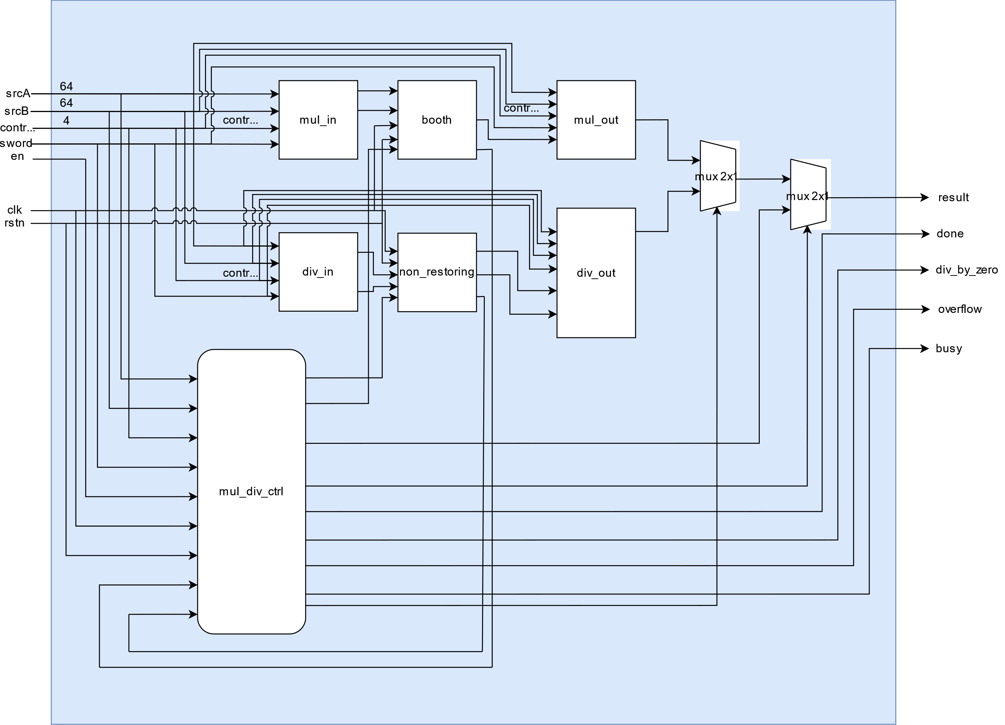
Microarchitecture of M-Extension.

Slide 70
Microarchitecture of M-Extension.
The microarchitecture consists of:
Input Blocks
Multiplication and Division Blocks
Performing unsigned operations
Output blocks
Controller

Slide 71
Multiplier
Mul_in Block:
adjust the two inputs srcA and srcB to get the proper multiplicand and multiplier

Slide 72
Multiplier
Each instruction needs a proper adjustment.
mul and mulh: if either one of the two inputs is negative, get its positive value using two’s complement.
mulhsu: if the multiplicand is negative, get its positive value using two’s complement.
mulhu: no adjustment needed.
mulw: take only the first 32-bit since it’s a word operation and get the positive value if there is a negative input.

Slide 73
Multiplier
Booth Block:
Performs the multiplication using fast algorithm

Slide 74
Multiplier
Multiplier Algorithm:
Initialization
Load the multiplier.
Set the counter to 32 (for 32-bit multiplication).
Iterative Multiplication in MUL State:
Check the LSB of the multiplier.
If 1, add the multiplicand to the accumulator, if 0, do nothing
Perform an arithmetic right shift on the combined registers {carry, accumulator, and multiplier}.
Decrement counter.
Result
If the counter reaches 0, the result is in the combined accumulator and multiplier.

Slide 75
Multiplier
Mul_out Block:
responsible for adjusting the sign of the product result of the signed instructions (Mul, Mulh, Mulhsu and Mulw).

Slide 76
Divider
Div_in Block:
Same as the multiplier we need to adjust the inputs of the operation, Since the non-restoring algorithm is unsigned

Slide 77
Divider
Non_restoring block:
responsible for performing the division.

Slide 78
Divider
Non-Restoring Algorithm:

Slide 79
Divider
Non-Restoring Algorithm:

Slide 80
Divider
Non-Restoring Division Steps:
In this step, the corresponding values are initialized in the registers as follows: register A is set to 0, register M holds the Divisor, register Q contains the Dividend, and N specifies the number of bits in the Dividend.
In this step, we will check the sign bit of A.
If the bit in register A is 1, shift the combined value of AQ to the left and perform the operation A = A + M. If the bit is 0, shift the combined value of AQ to the left and perform the operation A = A - M. In the case of 0, this involves adding the 2's complement of M to register A, with the result stored in A.

Slide 81
Divider
Non-Restoring Division Steps:
check the sign bit of A again.
If the bit in register A is 1, then Q[0] will be set to 0. If the bit is 0, then Q[0] will be set to 1. Here, Q[0] refers to the least significant bit of Q.
Then, the value of N, which serves as a counter, will be decremented.
If the value of N = 0, then we will go to the next step. Otherwise, we must again go to step 2.
If the sign bit of register A is 1, we will execute A = A + M.
In this step, register A holds the remainder, and register Q contains the quotient.

Slide 82
Divider
Div_out Block:
responsible for adjusting the sign of the product result of the signed instructions (div, divw, rem and remw).
Assign the quotient or the remainder to the output of the block according to the instruction (division or remainder)

Slide 83
M-Extension Controller
Its primary role is to ensure efficient and accurate execution of M-Extension instructions by coordinating the necessary control signals and handling data flow within the processor.
The controller optimizes performance by implementing fast paths for simple operations (fast operations).

Slide 84
M-Extension Controller
The finite state machine of the controller block which have four states:
IDLE
MUL: Performs multiplication
DIV: Performs division
FAST: Performs fast operations

Slide 85
M-Extension Controller

Slide 86
M-Extension Controller
Block Diagram:

Slide 87
M-Extension Controller
Fast Operations:
We added Another feature to the implementation of the M-Extension, which is fast operations, fast operations mean preforming the basic operations during only one clock cycle and not waiting 32 clock cycles.
We created two registers, one for double word instructions and the other for word instructions. Each one is 7-bit wide. These two registers indicate whether one of the operands is -1, 0, 1, or indicate an overflow value.
Fast DW Reg | B = -1 | B = 1 | B = 0 | A = -1 | A = 1 | A = 0 | Overflow
Fast W Reg | B = -1 | B = 1 | B = 0 | A = -1 | A = 1 | A = 0 | Overflow

Slide 88
M-Extension Controller
Assuming A is the dividend or multiplicand, and B is divisor or multiplier, then, Fast operations are as shown in the below table
Fast_reg | Instr | Operation | Fast_out
7’b1000001 | REM | Overflow | 0
 | DIV |  | 32’h8000_0000_0000_0000
7'b001xxx0 | REM(U) | A%0 | A
 | DIV(U) | A/0 | 32’hFFFF_FFFF_FFFF_FFFF

Slide 89
M-Extension Controller
Fast Reg | Instruction | Operation | Fast_Out
7'b1000000 | REM(U) | A%-1 | 0
 | DIV(U) | A/-1 | 2’s comp of A
 | MUL | A*-1 | 2’s comp of A
 | MULH(SU)(U) |  | 32’hFFFF_FFFF_FFFF_FFFF
7’b0100000 | REM(U) | A%1 | 0
 | DIV(U) | A/1 | A
 | MUL | A*1 | A
 | MULH(SU)(U) |  | not fast operation
7'b1001000 | REM(U) | -1%-1 | 0
 | DIV(U) | -1/-1 | 1
 | MUL | -1*-1 | 1
 | MULH |  | 0
 | MULHSU(U) |  | not fast operation

Slide 90
M-Extension Controller
Fast Reg | Instruction | Operation | Fast_out
7'b1000100 | REM(U) | 1%-1 | 0
 | DIV(U) | 1/-1 | -1
 | MUL | 1*-1 | -1
 | MULH |  | -1
 | MULHSU(U) |  | not fast operation
7'b0101000 | REM(U) | -1%1 | 0
 | DIV(U) | -1/1 | not fast operation
 | MUL | -1*1 | -1
 | MULH |  | 0
 | MULHSU(U) |  | -1
7'b0000100 | REM(U) | 1%B | 1
 | DIV(U) | 1/B | 0
 | MUL | 1*B | B
 | MULH(SU)(U) |  | 0

Slide 91
M-Extension Controller
Output flag signals:
Done: Indicates that an operation has completed.
Div_by_zero: Indicates a division by zero has occurred.
Overflow: Indicates that an overflow has occurred.
Busy: Indicates that M unit is currently busy.

Slide 92
Results

Slide 93
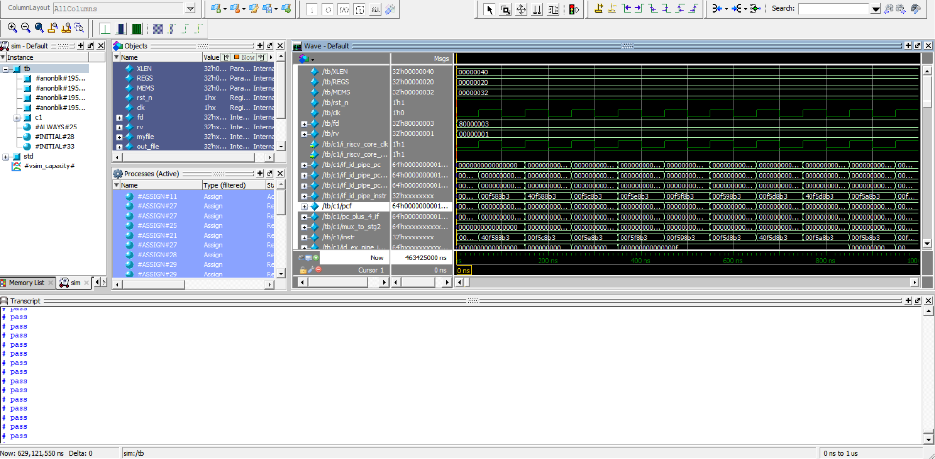
R-Type

Slide 94
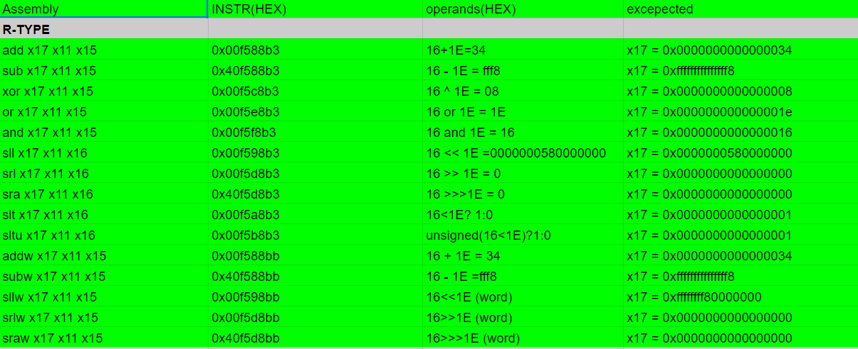
R-Type
Link

Slide 95
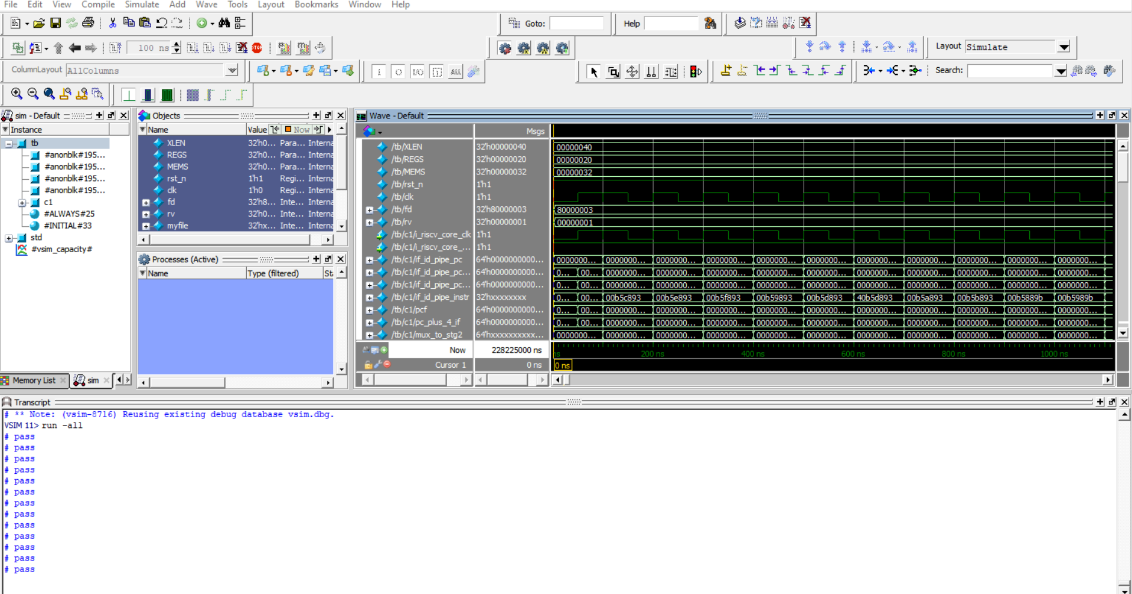
I - TYPE

Slide 96
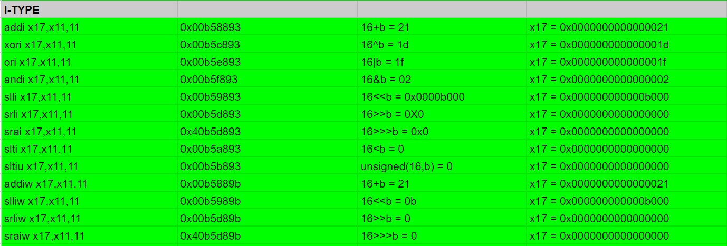
I - TYPE

Slide 97
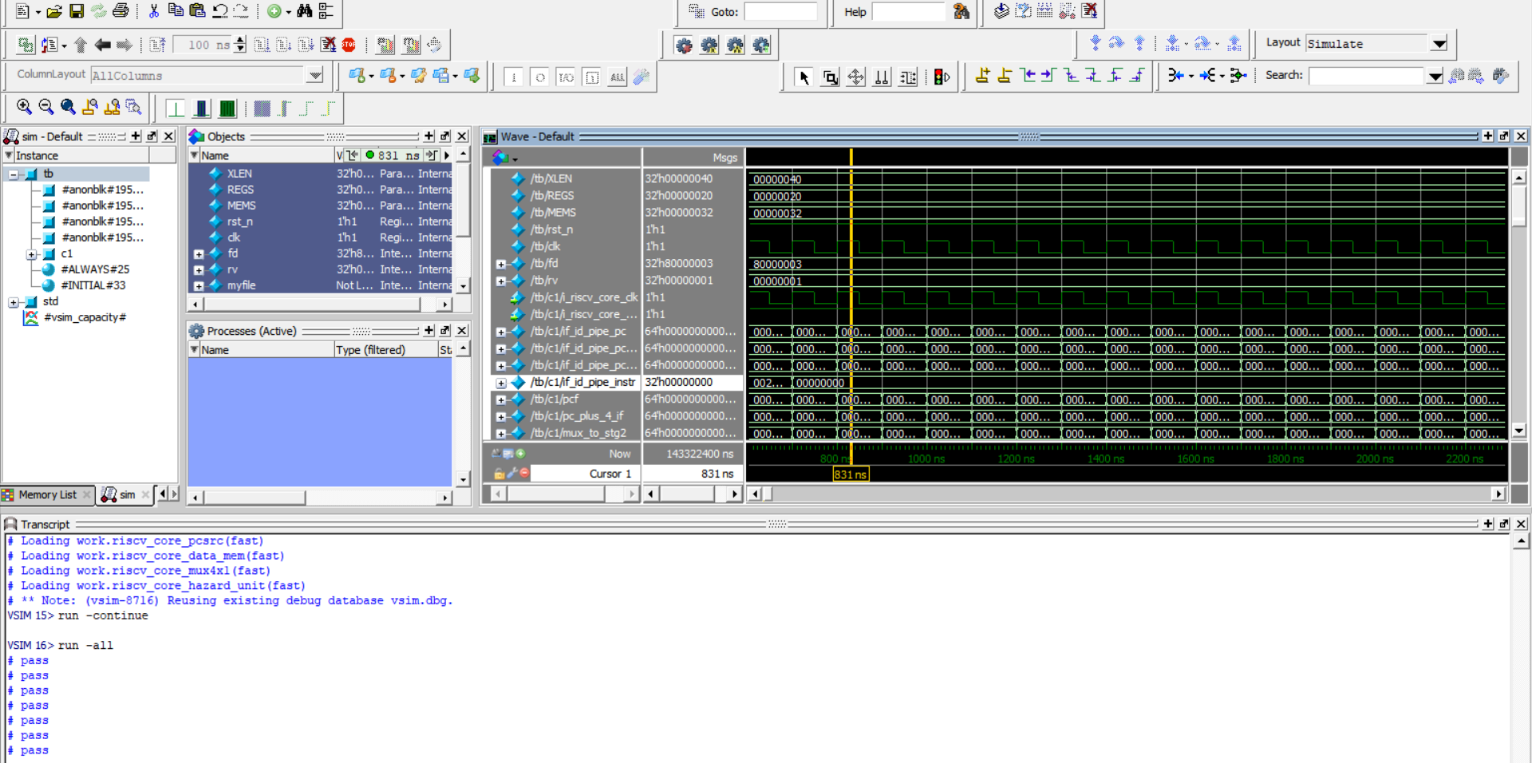
Load instructions

Slide 98
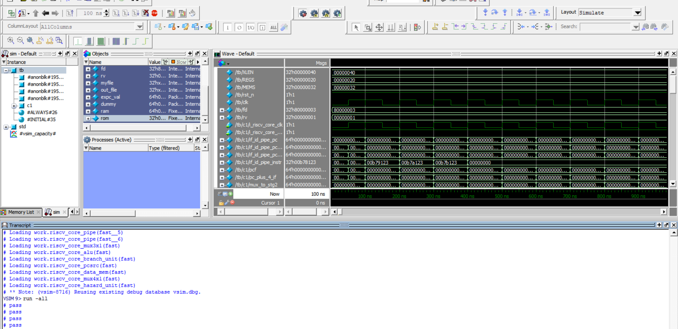
S-type

Slide 99
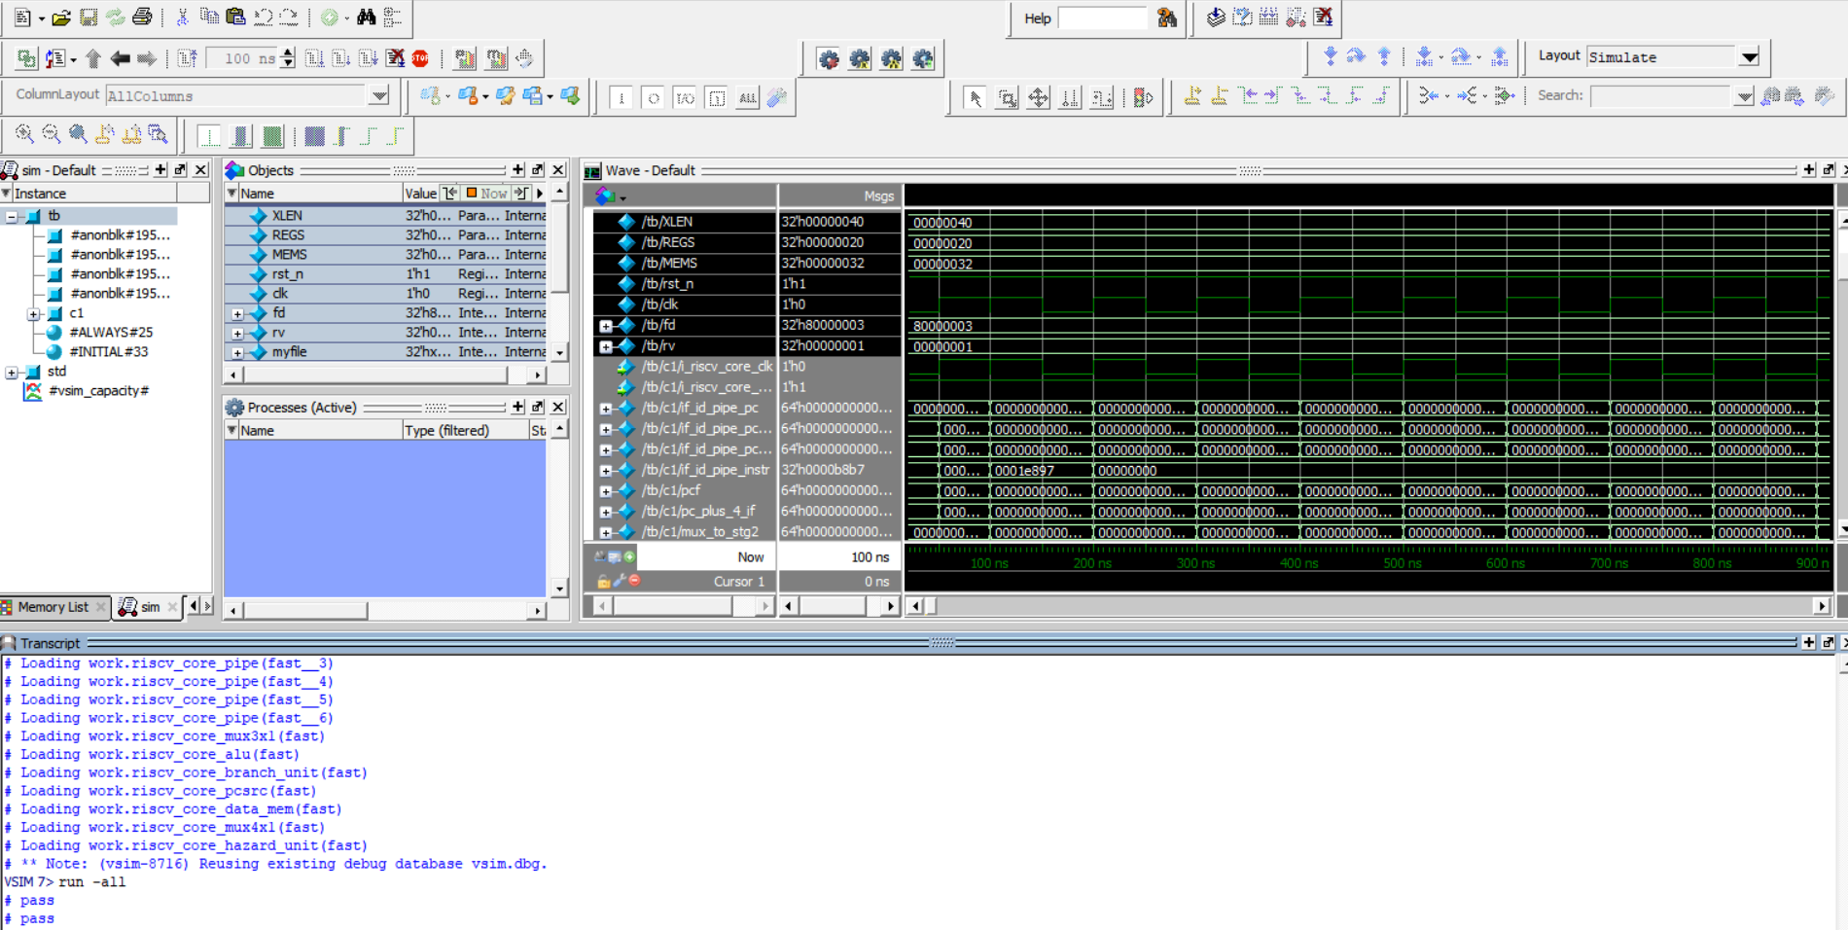
U-type

Slide 100
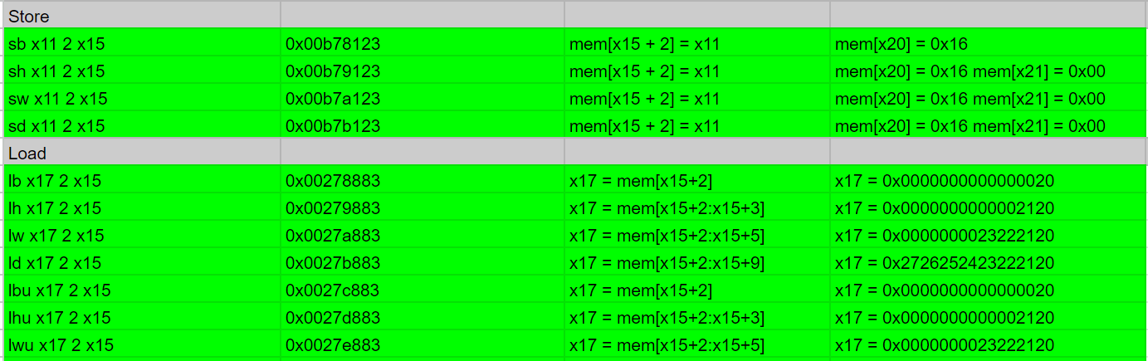
STORE/LOAD/ U-TYPE

Slide 101
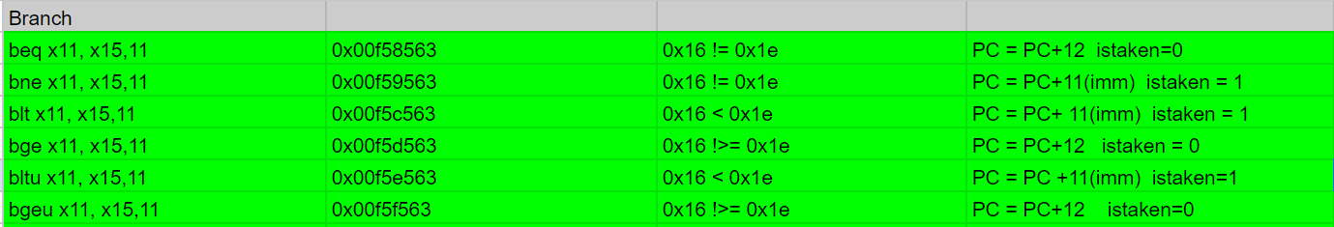
BRANCH/JUMP

Slide 102
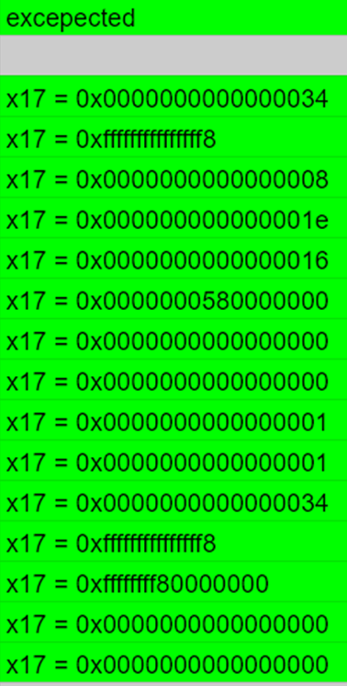
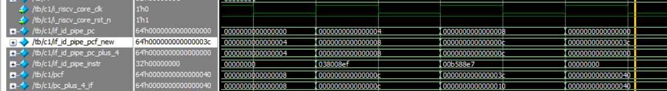
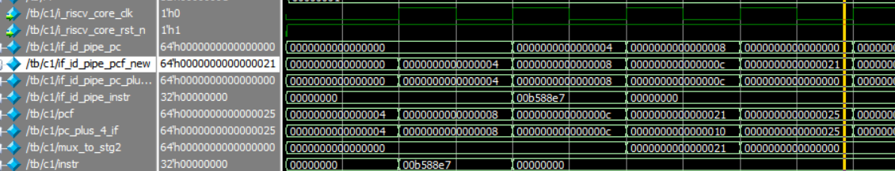
JUMP
OUR OUTPUT
1. . jal x17 56
4 + 38 = 3c
2. . jalr x17 x11 11
1. .
2. .
16 + 0B = 21

Slide 103
FPGA Implementation

Slide 104
FPGA implementation and applications
I. Implementation:
Constrains
Synthesis Reports
Implementation Reports
II. Applications:
LEDs Testing
Sending Characters using UART

Slide 105
FPGA implementation and applications
I. Implementation:
Constrains
Synthesis Reports
Implementation Reports
II. Applications:
LEDs Testing
Sending Characters using UART

Slide 106
Synthesis Reports
Timing Report
Power Report
Utilization Report

Slide 107
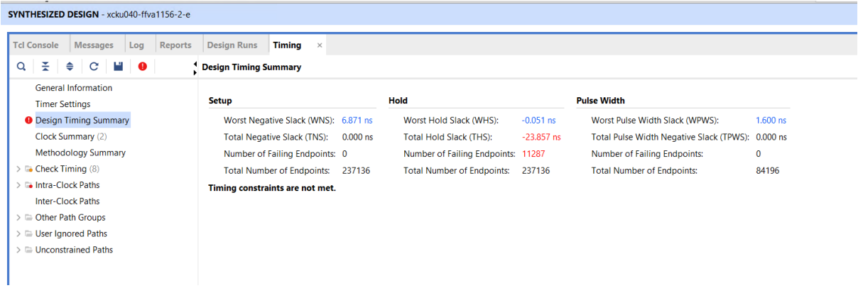
Timing Report
Large setup slack
Negative hold slack

Slide 108
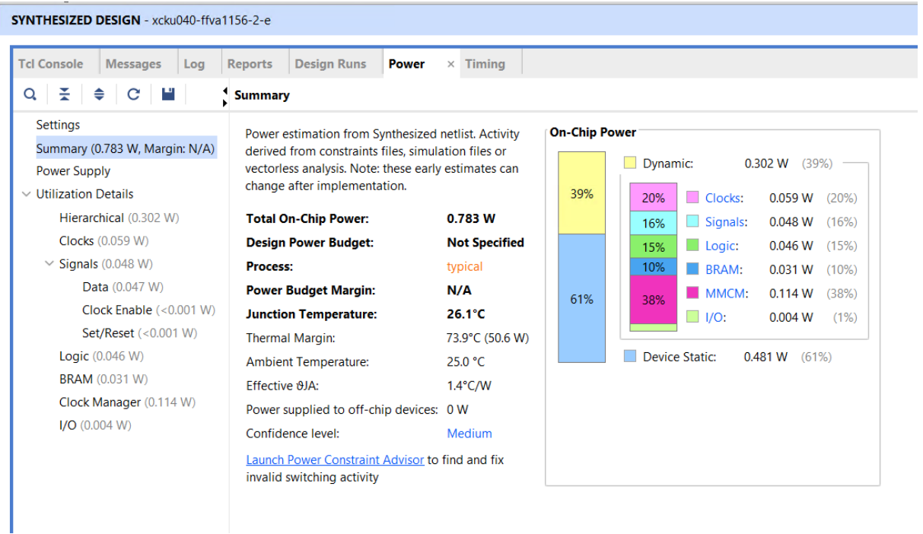
Power Report

Slide 109
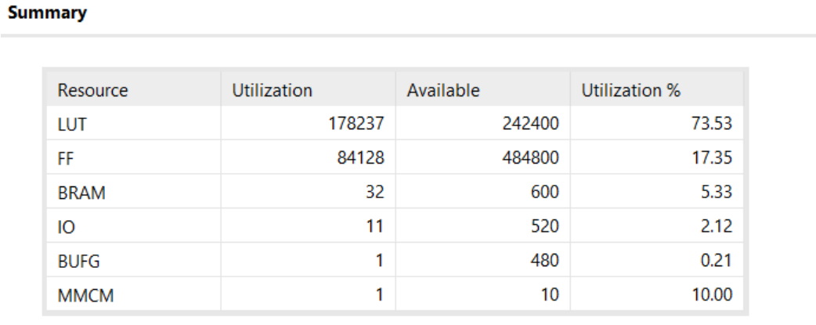
Utilization Report

Slide 110
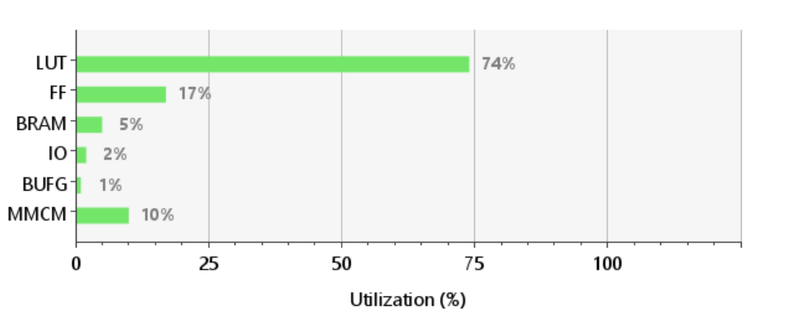
Utilization Report

Slide 111
FPGA implementation and applications
Implementation:
Constrains
Synthesis Reports
Implementation Reports
II. Applications:
LEDs Testing
Sending Characters using UART

Slide 112
Implementation Reports
Timing Report
Power Report
Utilization Report

Slide 113
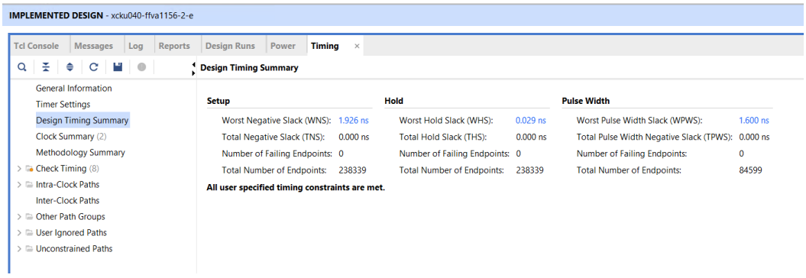
Timing Report

Slide 114

Power Report

Slide 115
Implementation Reports
Timing Report
Power Report
Utilization Report

Slide 116

Utilization Report

Slide 117


Utilization Report

Slide 118
FPGA implementation and applications
I. Implementation:
Constrains
Synthesis Reports
Implementation Reports
II. Applications:
LEDs Testing
Sending Characters using UART

Slide 119

Application 1: LEDs Testing
Objective:
It tests RISC-V specific operations while turning a LED on is the indication to the success of these operations. These operations are as follows:
• Integer (add, or, xor and slt).
• Multiplication.
• Compressed.
• Atomic.

Slide 120
Application 1: LEDs Testing

Slide 121


Assembly Program for App 1

Slide 122


Assembly Program for App 1

Slide 123

Assembly Program for App 1

Slide 124
THANK YOU

